Slide 1

Building Your Personal Brand on Social Media as and Effective Job Search Strategy
Leanne Raynor
May 2021

Slide 2
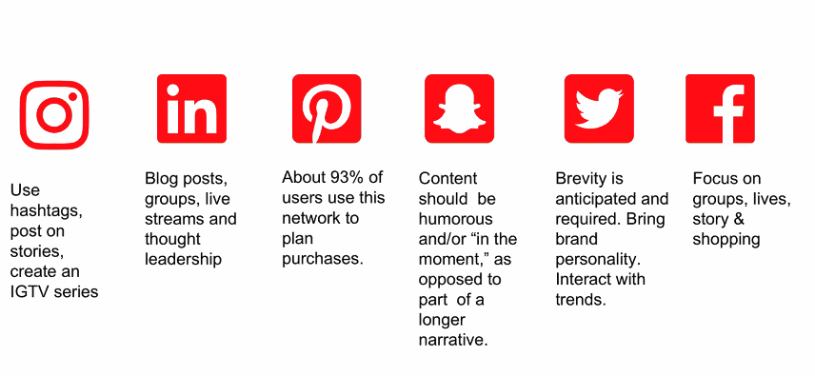

What is Social Media?
Social media is computer-based technology that facilitates the sharing of ideas, thoughts, and information through the building of virtual networks and communities.
Notes:
Examples of social media and what they are good for. In job searching, branding on LI and Twitter are most important. Maintaining a positive brand on the other mediums is important

Slide 3
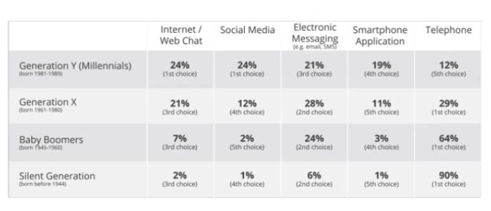
Different Demographics Engage Different Ways
Notes:
This is why we need to be active on social media. younger generations (including hiring managers and recruiters) are digitally minded

Slide 4


Slide 5

Personal Brand
You’re a brand. I’m a brand.
We’re all brands, whether we aim to be or not.
Notes:
Who has an Apple computer? Ask folks about Apple versus Microsoft
Facebook’s image was tarnished by political ads

Slide 6
Social Media - Branding Keys
Personal branding is the process of managing and optimizing the way that you are presented to others and what others think of you.
Social media is one of the keys (if not the biggest key) to managing your personal brand online.
What is your online reputation?

Slide 7





How many have…
Googled yourself?
Facebook Page?
LinkedIn account?
Twitter account?
Instagram account?

Slide 8

SUM TOTAL | It adds up
Who you are
What you do
How you interact with contacts/peers and content online can build (or hurt) your brand

Slide 9
Personal Case Study

Slide 10
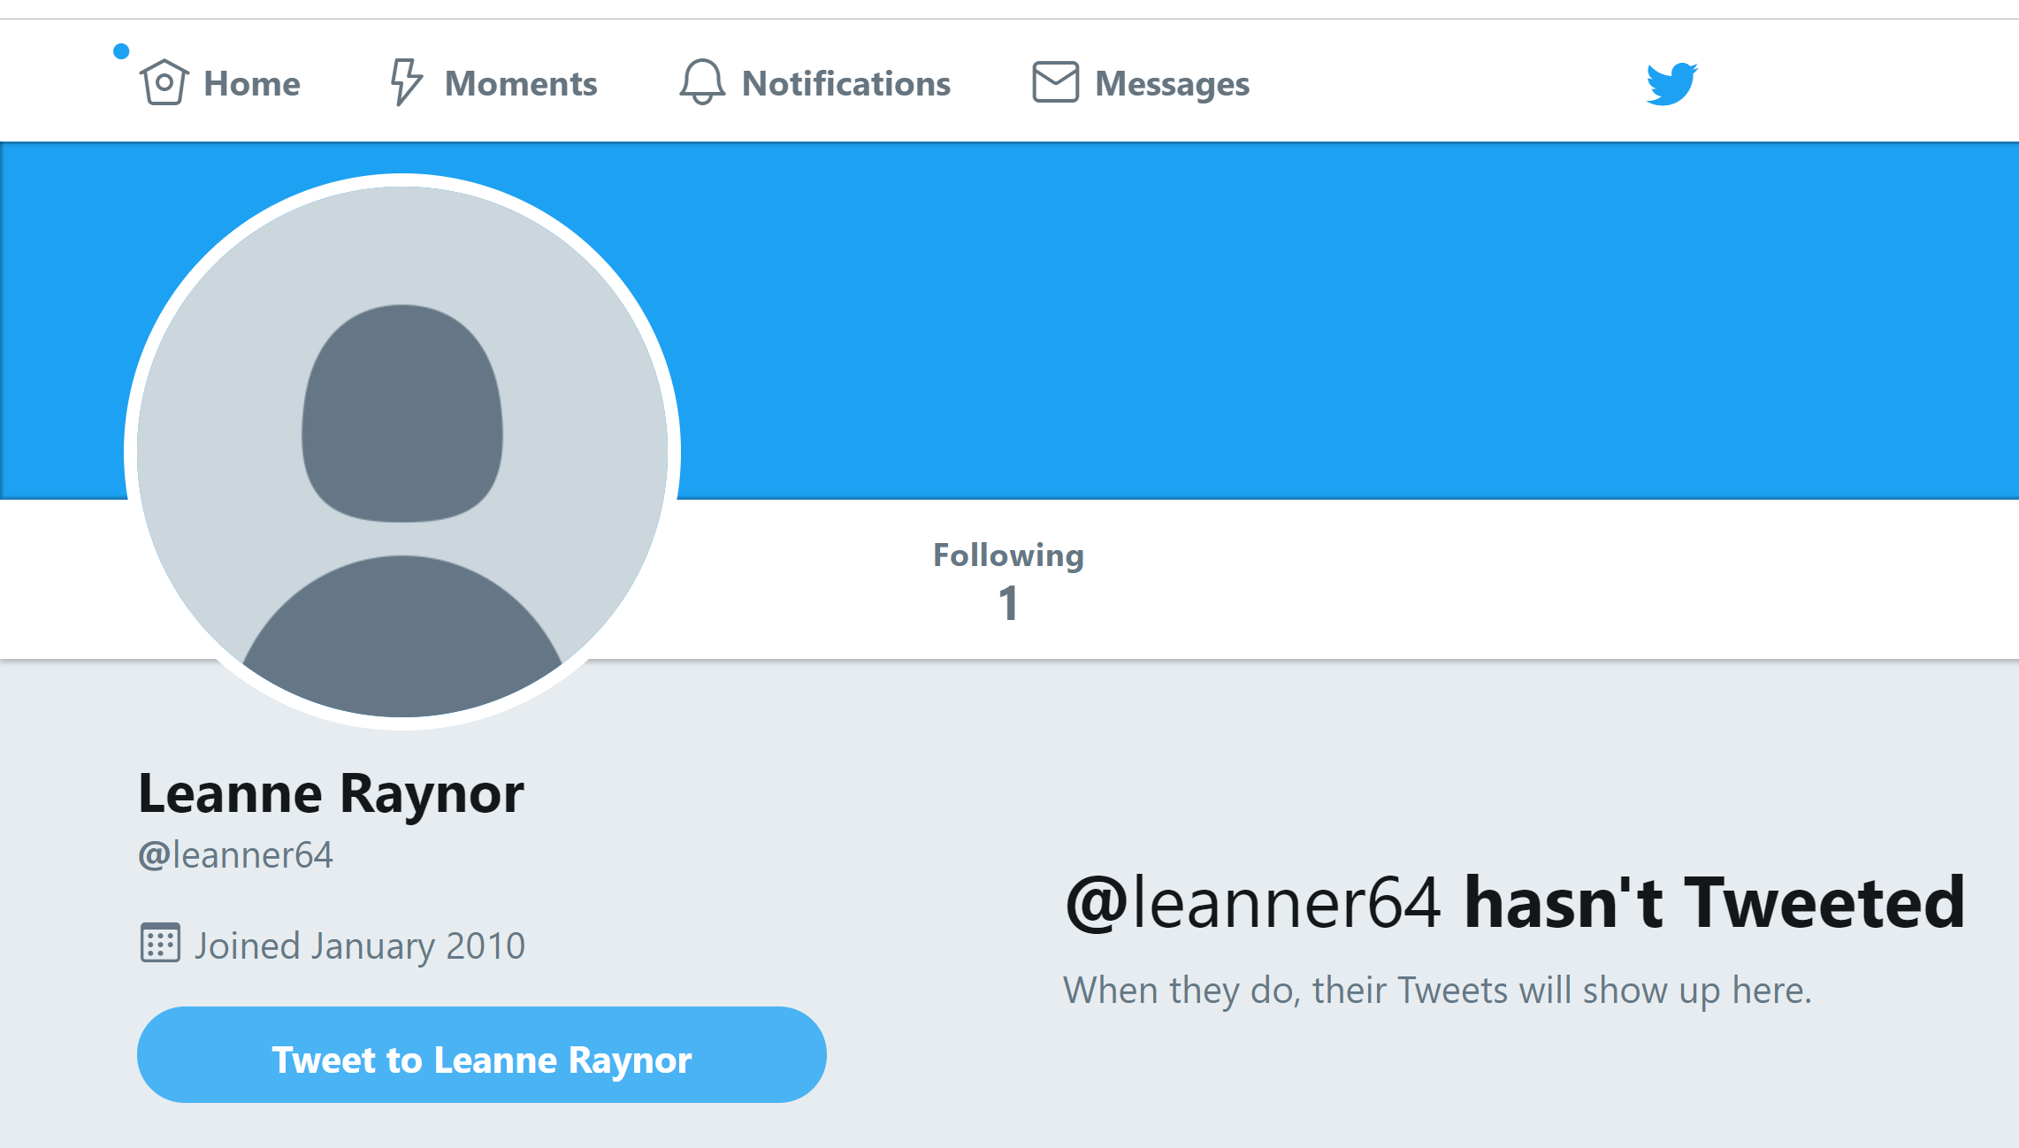
Social Media - Past
Joined Career Prospectors in June 2014.
No LinkedIn account prior to 2014.
Twitter account following one handle to find out when the state offices were delayed for weather.
Notes:
Gray shroud
No background photo
No bio
Birth year in handle name
No tweets
Username with my birth year
Birth year in my user name
No followers
No tweets

Slide 11
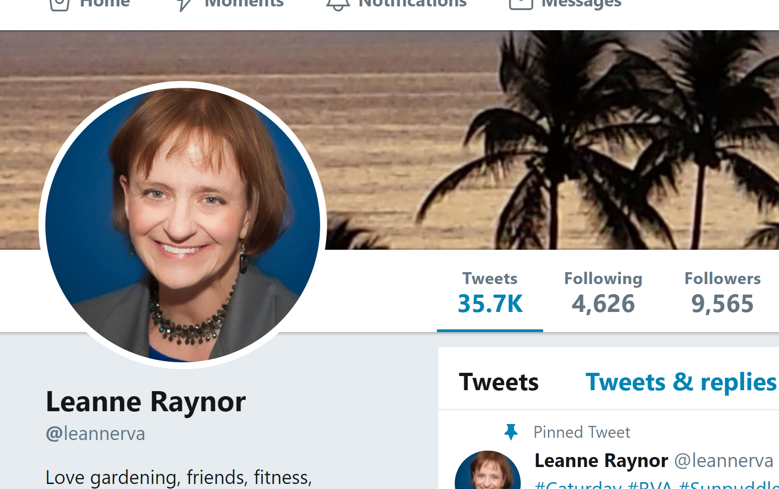
Social Media - Current
9900+ Twitter Followers
Influencer
2700+ LinkedIn connections
250 Instagram followers

Slide 12
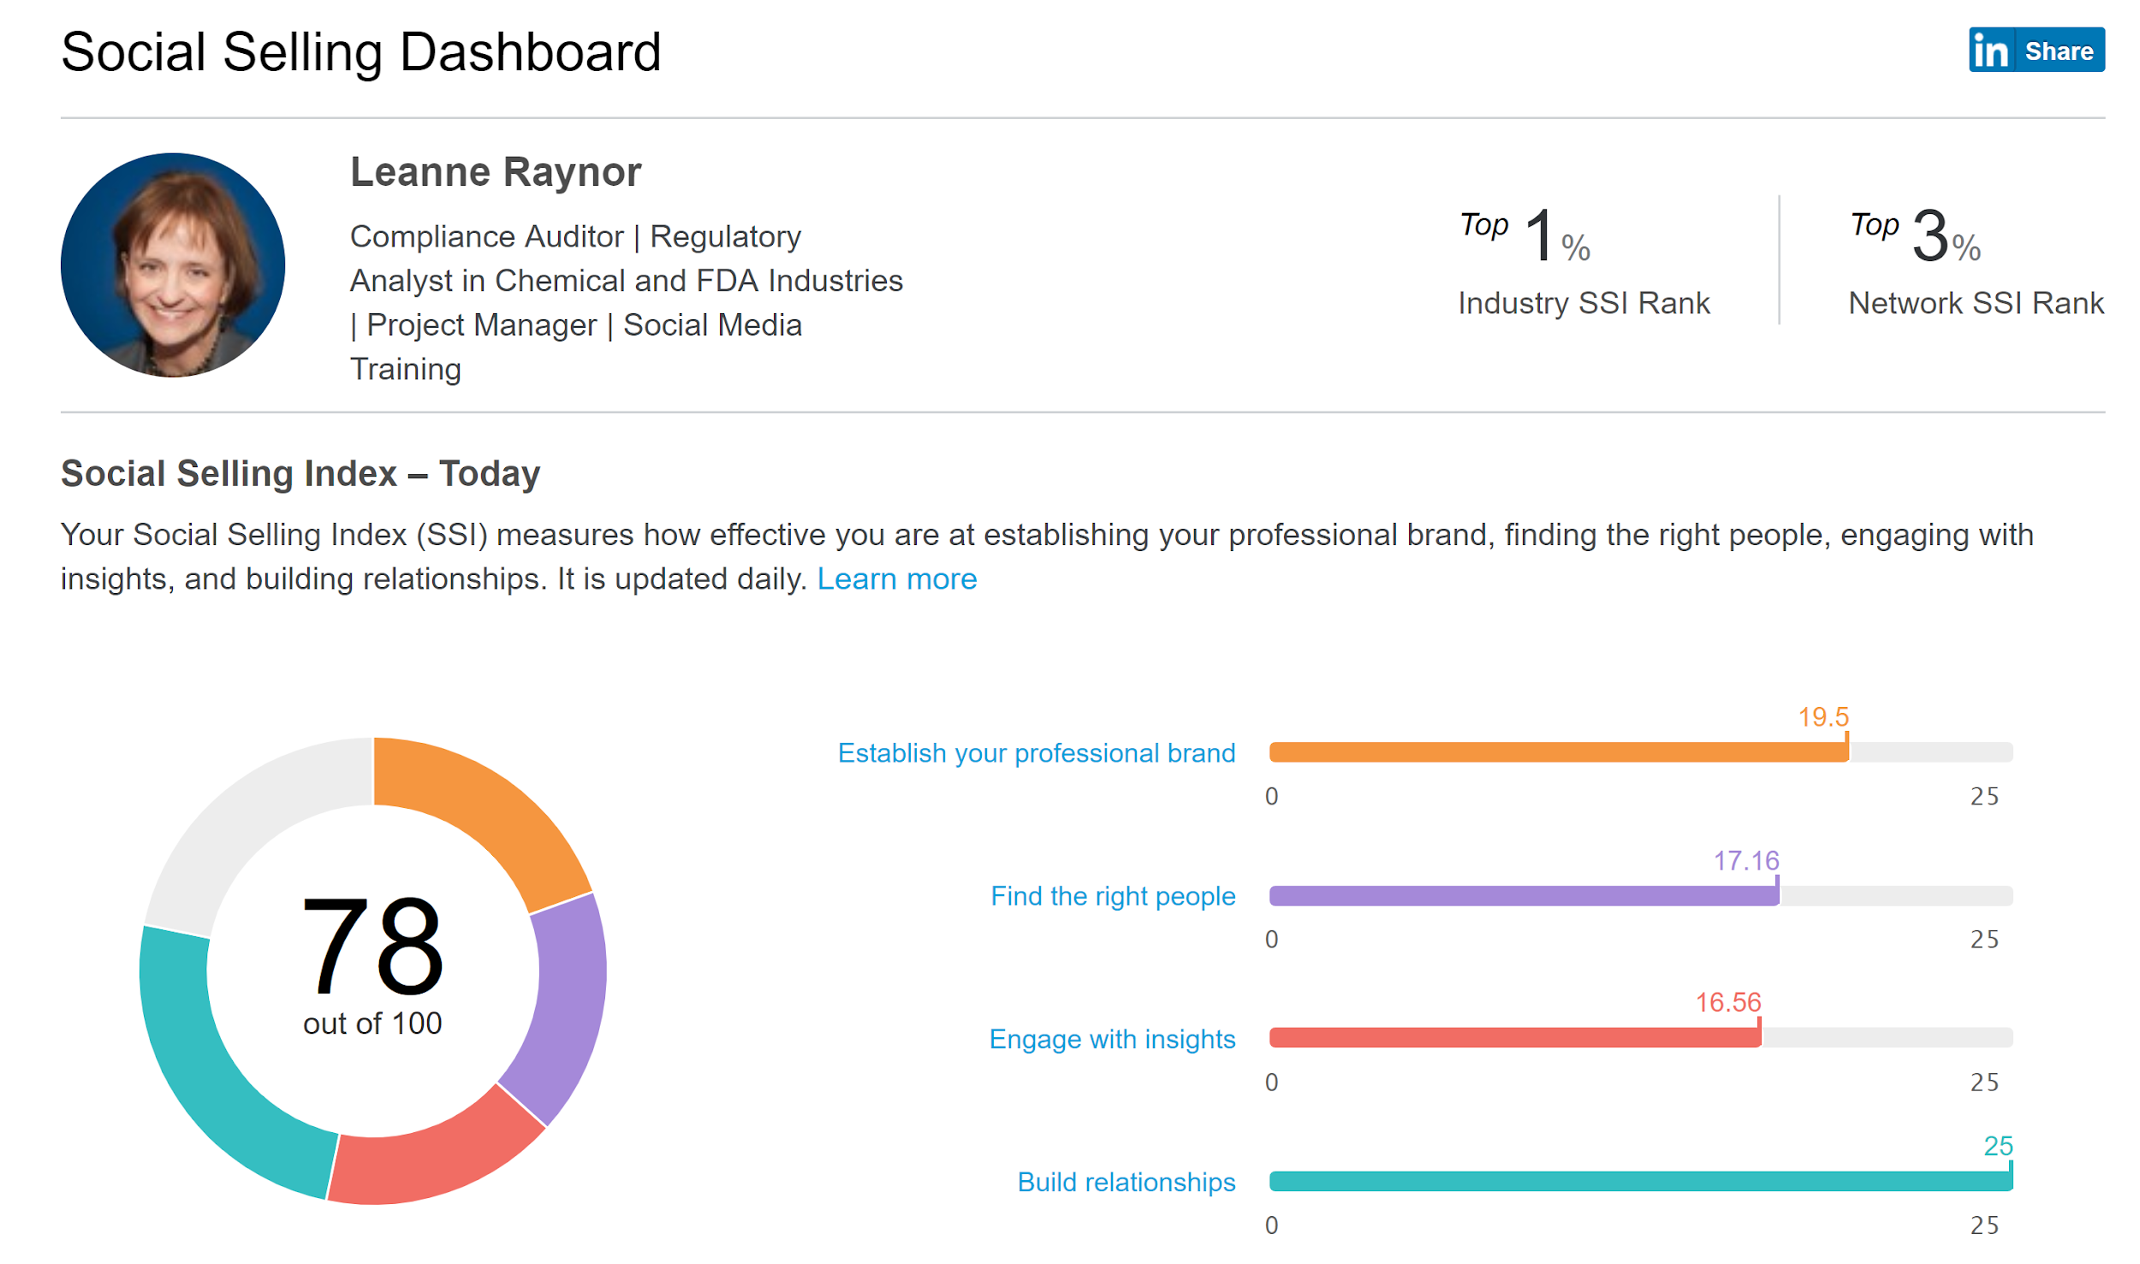
Social Selling Dashboard

Slide 13
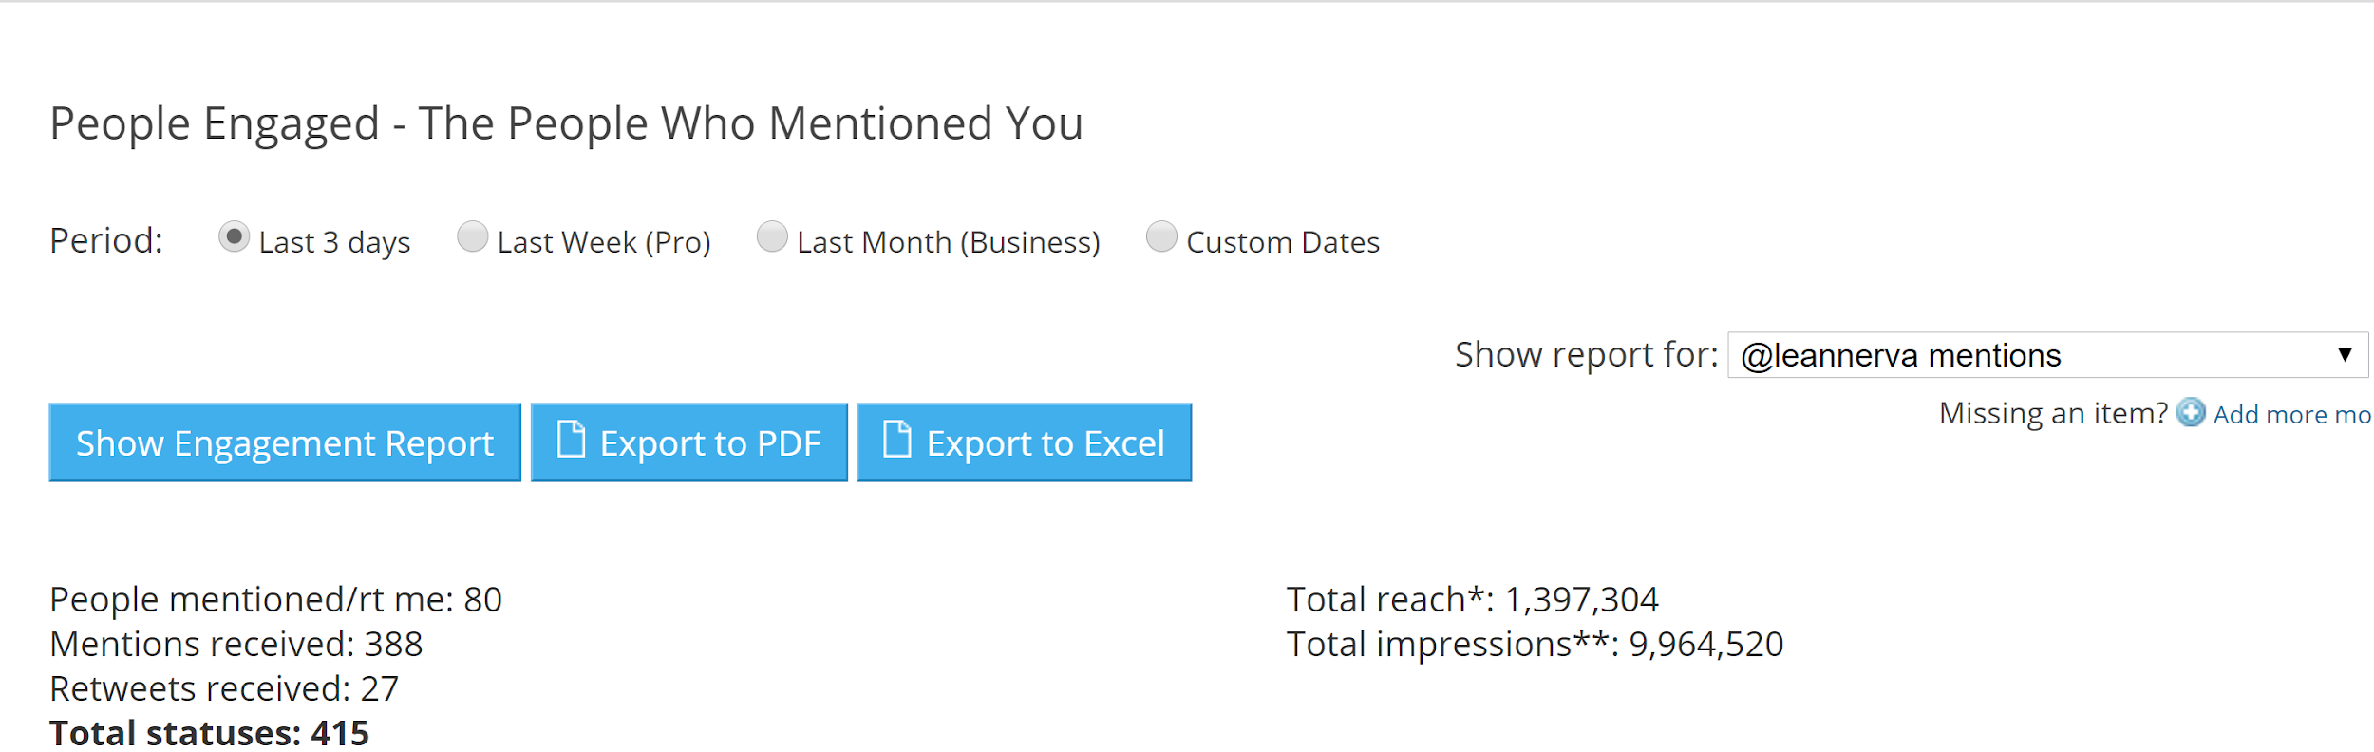
Twitter Engagement Snapshot

Slide 14
LinkedIn

Slide 15

LinkedIn (LI)
LI is the professional social networking platform
It hosts more than 600 million profiles and an unlimited supply of network connections and job opportunities.
Powerful tool for building your professional brand and can help rank your name on Google
Research companies and employees; tap into industry news; and network!
Specialty or niche to stand out that makes them valuable
Notes:
Top ten connections in my network are from Twitter.

Slide 16
LinkedIn Social Selling Index
LinkedIn describes its SSI score as “the first-of-its kind social selling measurement”. It awards 25 points maximum for each of these ‘pillars’:
Establishing your professional brand
Finding the right people
Engaging with insights
Building relationships
LinkedIn claims that those who achieve 70 or higher, see 45% more opportunities and are 51% more likely to hit sales targets.
Notes:
Top ten connections in my network are from Twitter.

Slide 17
Start Building Your Influence on LinkedIn
Use your best professional headshot for your profile picture.
Develop a strong, polished profile. This is your online reputation. Make it honest, and make it look good.
Headline
About
Add people to your network. Don’t just wildly add anyone you see. Add people whom you know or who know you, and network with contacts at the companies you’re targeting.
Consistently share links, articles, and content that is relevant to your your industry and your target audience

Slide 18
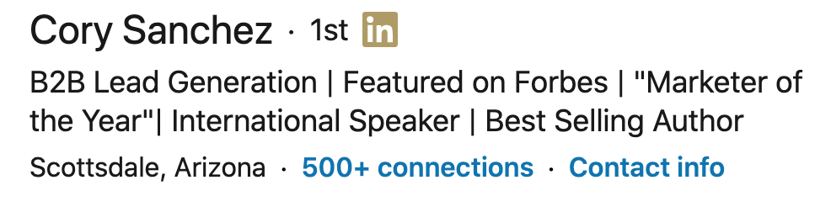
LinkedIn Headline
Probably most important part of your page be concise, creative and use key terms relevant to your industry
Your headline is an opportunity to show what you are –not just what you do. When writing your headline, ask yourself:
If this is the only thing someone sees, what does it convey about me?
Does this represent my professional brand and show why I am unique?
Does it capture what a recruiter would care about?
Notes:
Details in your headline are shared each time you post, like, or share information.
Side note on gmail account, also include your picture, email signature, and keywords. (Yahoo & Hotmail accounts may make you appear dated).

Slide 19
About Section - Personal Branding Statement
The best place for you to communicate your professional brand and put your own spin on your experience.
Make sure to include your key strengths, special qualities / characteristics, top accomplishments, and education / training / certification / awards
1-2 sentences about who you are
3-5 sentences about your experience, top skills and key passions
1-2 sentences about your future goals and how other members can engage with you

Slide 20
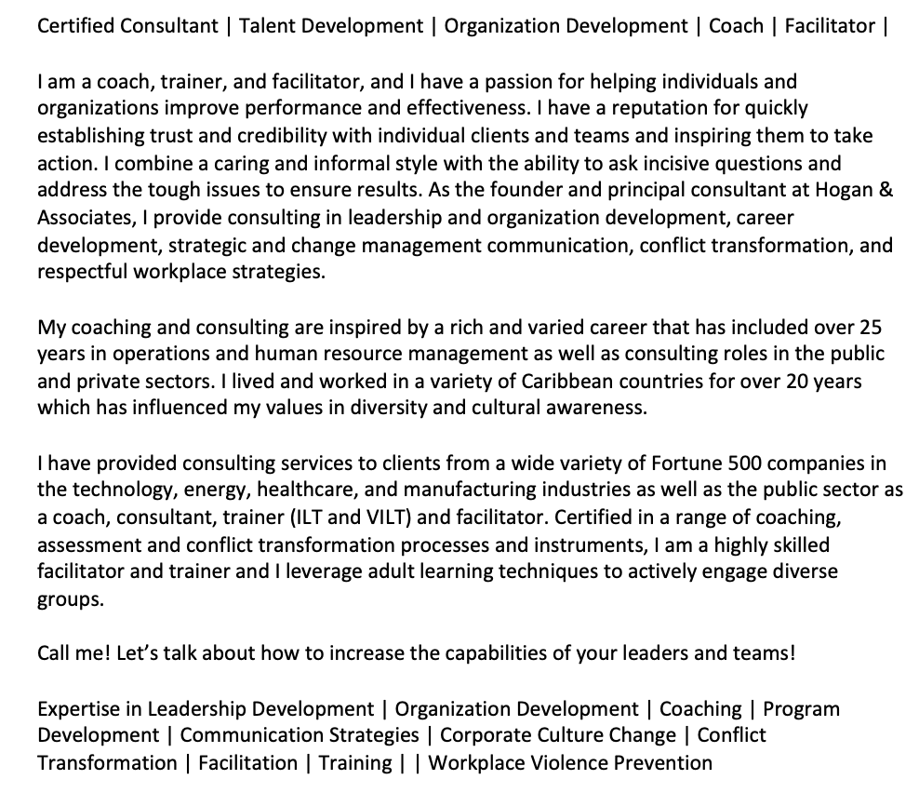
About Section - Personal Branding Statement

Slide 21
Build Your Network Strategically
Keep your personal profile and Page updated as much as you can
Add connections (people you know, influencers or contacts at companies you’d like to engage with).
Follow companies you’re interested in and influencers in your industry (these are different than connections on LinkedIn).
Join and participate in LinkedIn Groups, or host your own.
Give and receive recommendations.
Make sure your profile is public, so people can find you, add you and see your posts.
Join conversations and be active; like, comment and share content
Promote your LinkedIn pages on your website and in other appropriate spaces (e.g., employee bios, business cards, newsletters, email signatures, etc.).
Notes:
Make connections
Strive to reach 500+ (501)
Send personal invites to people who will connect with you. Have a routine for making connections. Thank people for connecting with you.
PERSONALIZE
Connect on the person’s profile.
You can personalize an invite on a mobile app.

Slide 22
Not All Posts are Created Equal
You should ask two questions when deciding what to post:
Who am I trying to reach?
What are they interested in?
LinkedIn ranks content based on quality and relevance and rewards authentic conversations and engagement. Sharing great content with your network, liking posts, making positive helpful comments, will improve your rankings.
Notes:
Post about problems that people are trying to solve You’re a business of one. Your target audience has niche needs

Slide 23
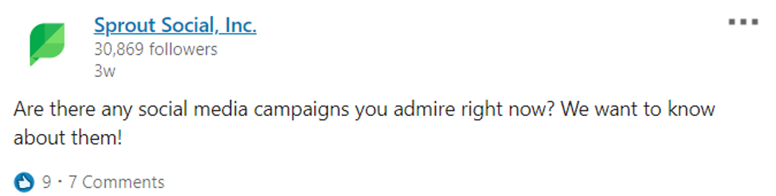
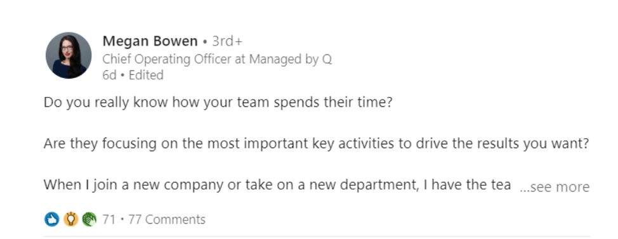
What types of posts do well on LinkedIn?
1. Question based posts (Encourages a conversation)
Long form post with question:

Slide 24
What types of posts do well on LinkedIn?
2. Breaking news and industry happenings
Posting about topical, time-sensitive news proves to followers that you have a pulse on your industry.
New studies, facts and statistics can also spark conversations among your audience.
Tip:
Check out your “news and views” feed on the right and click on the hashtags that you follow on the left

Slide 25
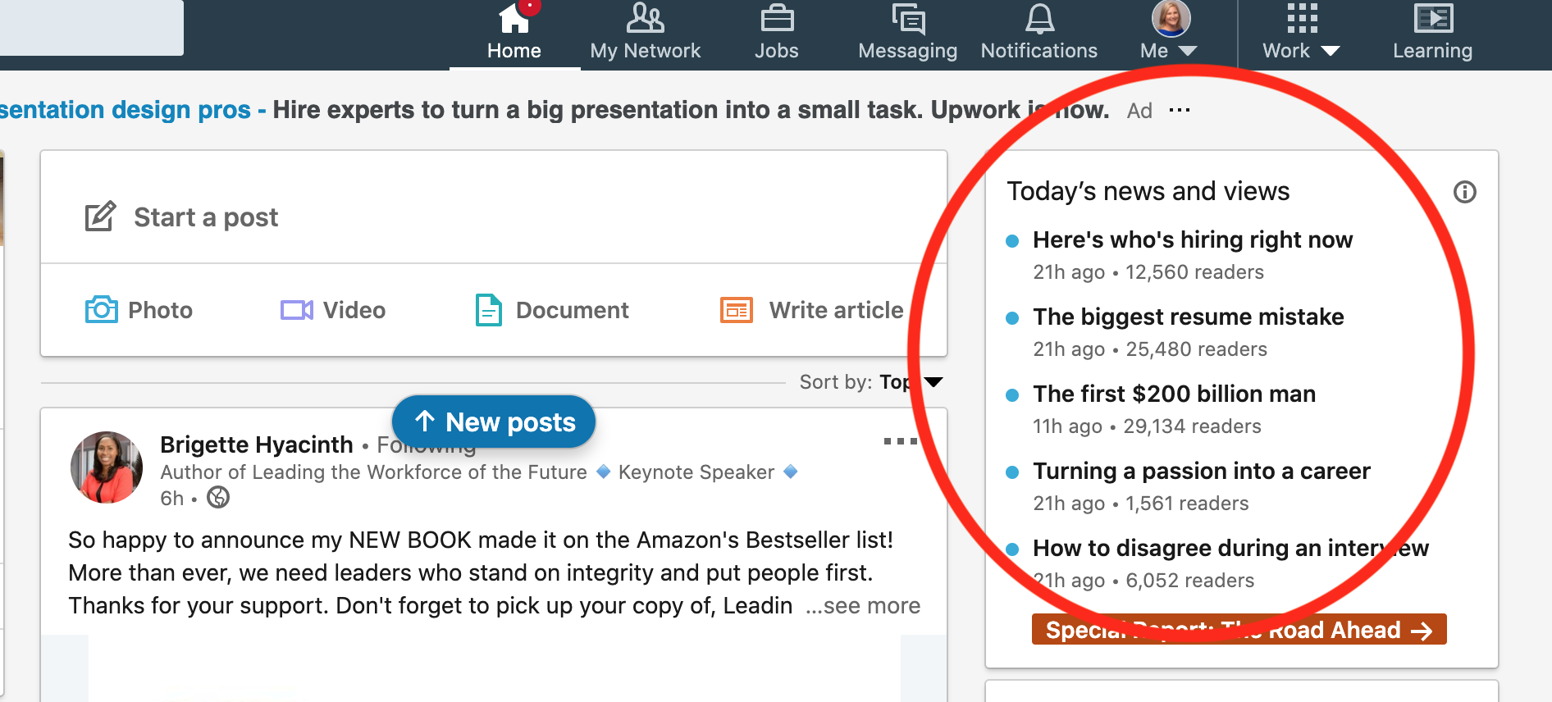
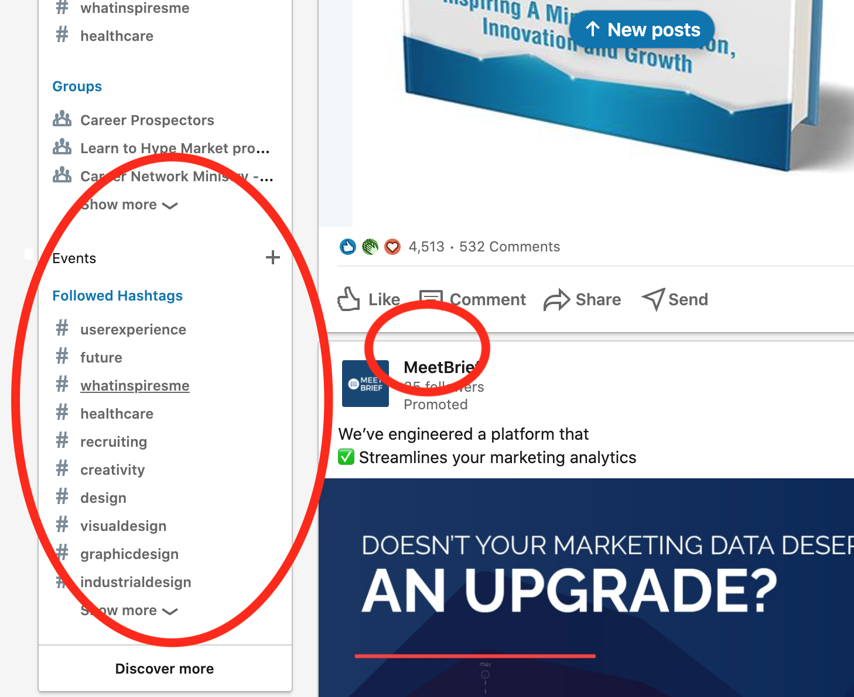
News & Views and Hashtags

Slide 26
What types of posts do well on LinkedIn?
3. Image based posts
Infographics
Video
Add/replace a photo with a post that is eye-catching
Free stock photo resources:
Pexels.com pixabay.com unsplash.com
Free design tool for social media graphic posts:
Canva.com
Notes:
Photos of a person get higher interaction

Slide 27
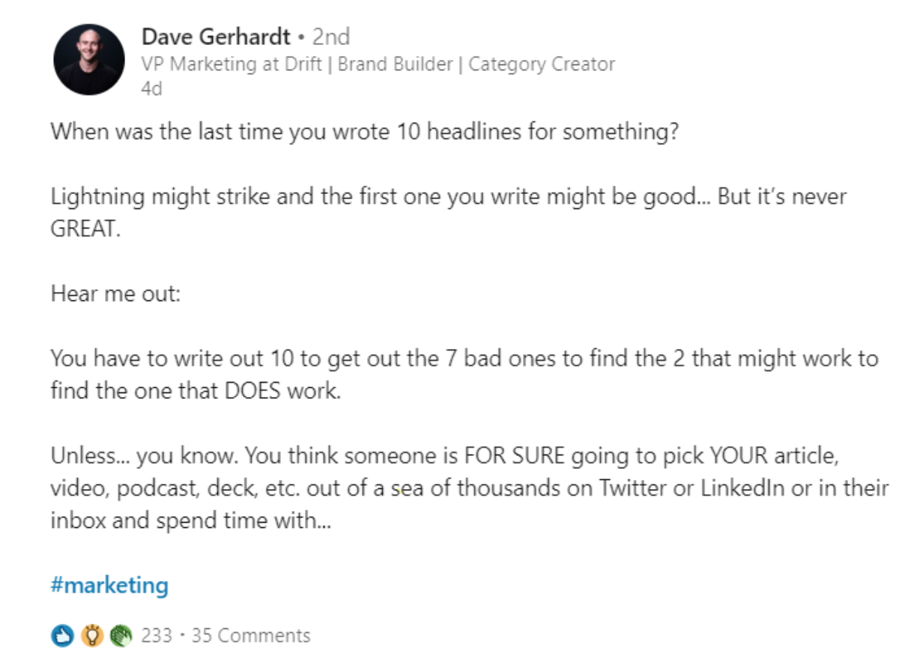
What types of posts do well on LinkedIn?
4. Event coverage – what events are you attending and what did you learn?
5. Award and accomplishments – did you just get a new certification?
6. Bite-sized punchy text posts

Slide 28
Posting strategy
To get noticed on LinkedIn, you want to develop a strategy to increase your profile views, post shares, and post comments
Follow companies that interest you so company updates are in your feed
Interact with content from network, groups, the companies and contacts/influencers that you follow
Regularly post content related to your network and start engaging conversations
Be mindful to post at the ideal time each day...
Notes:
Google alerts for company info and your name.

Slide 29
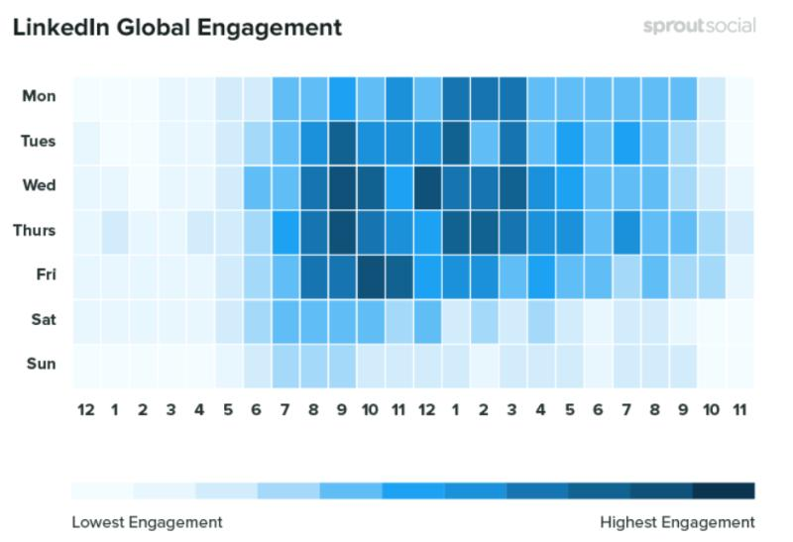
Best times to post to LinkedIn (since Covid)

Slide 30
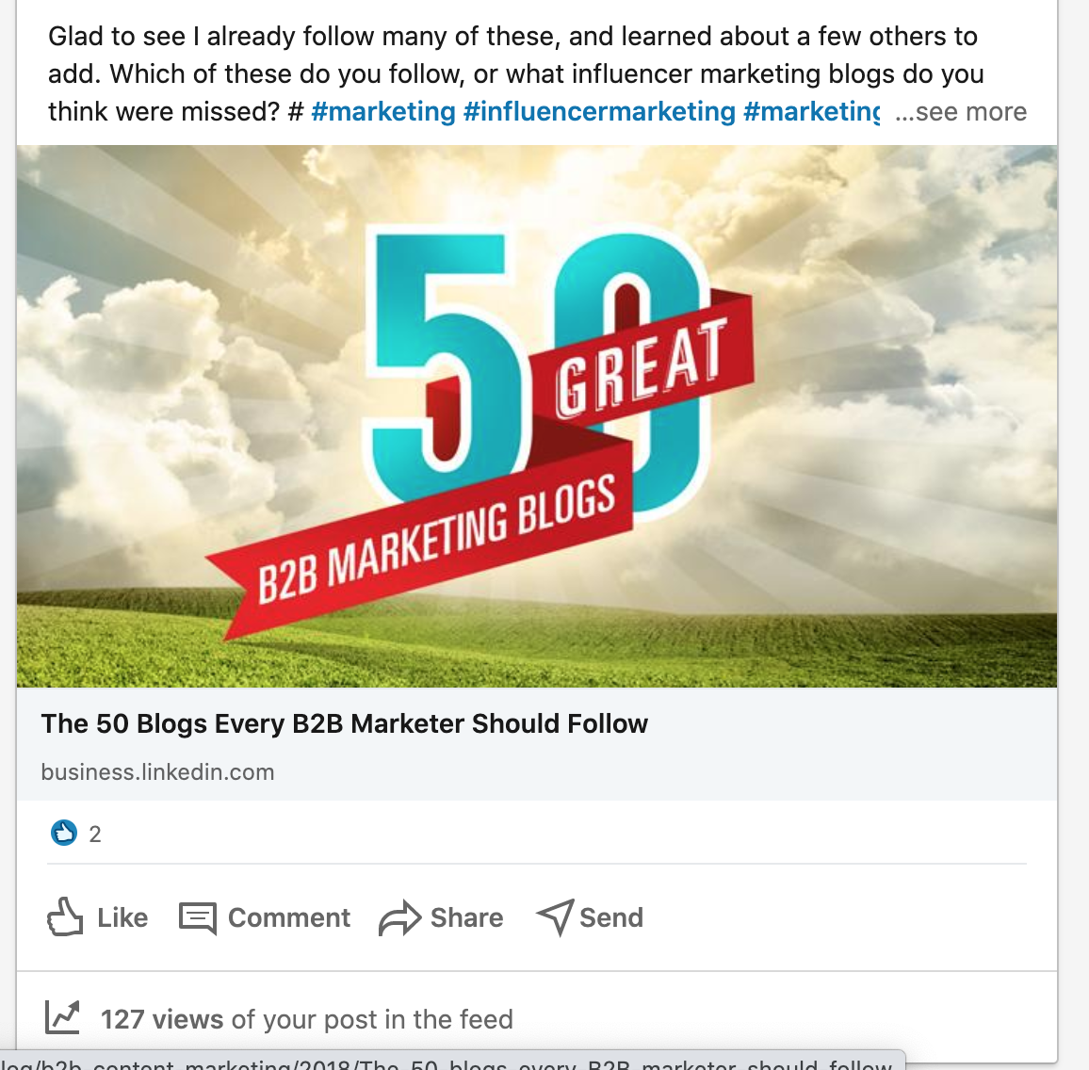
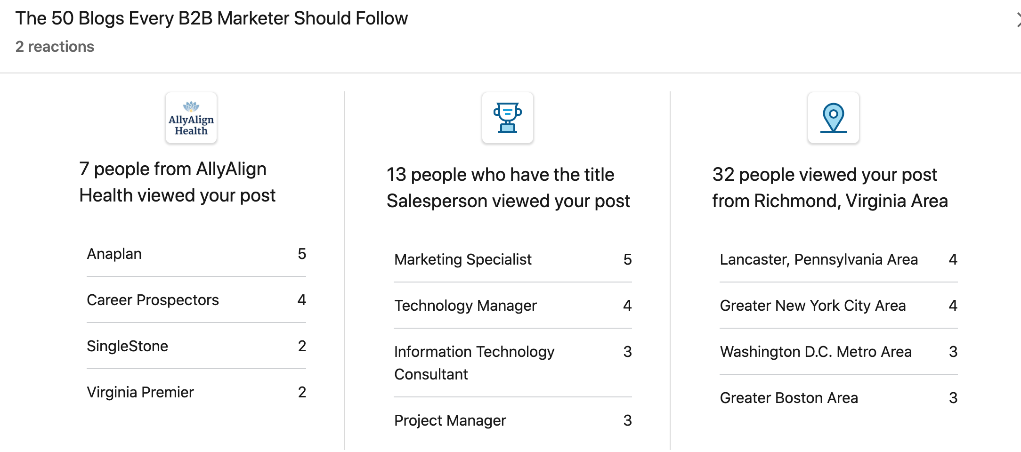
Be sure to check out the analytics for the posts that you share on LI

Slide 31
Premium Version of LinkedIn | To buy or not?
Costs about $30 a month
Every account receives one month for free. Virtual credit cards (links at the end) allow you to avoid tracking the 30 days
Every account can get one month free. Virtual credit cards (links at the end) allow you to avoid tracking
LinkedIn Learning (formerly Linda.com) is fabulous; amazing courses; completion of courses shows on your profile
Prestige of a paid account on your profile
Benefits of Premium LinkedIn
Notes:
Make connections
Strive to reach 500+ (501)
Send personal invites to people who will connect with you. Have a routine for making connections. Thank people for connecting with you.
PERSONALIZE
Connect on the person’s profile.
You can personalize an invite on a mobile app.

Slide 32
Twitter

Slide 33

Why Be on Twitter?
Twitter is popular among those under 50. You give the impression of being tech savvy.
Companies are on Twitter, tweeting opportunities & updates on their products and services, which could alert you to their needs.
Job search experts are on Twitter, tweeting valuable (and free!) information that can help you.
They’re all active on Twitter. You should be, too.
Notes:
Randolph Macon students
Effective way to find solve application issues
Complain, be very careful

Slide 34
What Can Twitter Do For You?
When leveraged in a professional manner (not merely random conversation),
Twitter
can cast a far-reaching net by expanding your network
position your personal brand of “you”
build visibility and create value to employers
retweet hiring decision makers at your target companies
retweet thought leaders in your industry
Notes:
No requirement to accept followers
Jon Thurmond HR Social hour

Slide 35
How To Start Using Twitter
Create a Twitter Username (@Name)-keep it professional
Bio - relevant, keyword-rich information, add your LinkedIn URL (160 characters)
Pin a tweet
Watch and read what others are tweeting
Start to follow people of interest
Start to follow companies of interest
Retweet relevant tweets
Notes:
Don’t add the year that you were born
Minimize underscore in your user name
Make your user name simple

Slide 36
Fundamentals of a Tweet
Use 200 characters per tweet to increase the retweets of your message (limit 280 characters)
Use links to a photo, article, video, blog – extension of your message (use a URL shortener)
Use hashtags (#keyword) to increase visibility
Capture reader’s interest using a question
Ask for help
Be personable/original

Slide 37
How to Tweet?
You need to contribute – tweet daily and on-topic
Make your tweets keyword-rich | Include #
Create lists to organize accounts
Reciprocate
Be consistent – don’t overload

Slide 38
How to grow your following
Marketing Pill
Follow 15 people a day
Unfollow 15 people a day
Retweet 5 posts a day
Engage with influencers
Help other people | They will help you
Include 2 hashtags in each post
Notes:
Randolph Macon students
Effective way to find solve application issues
Complain, be very careful

Slide 39
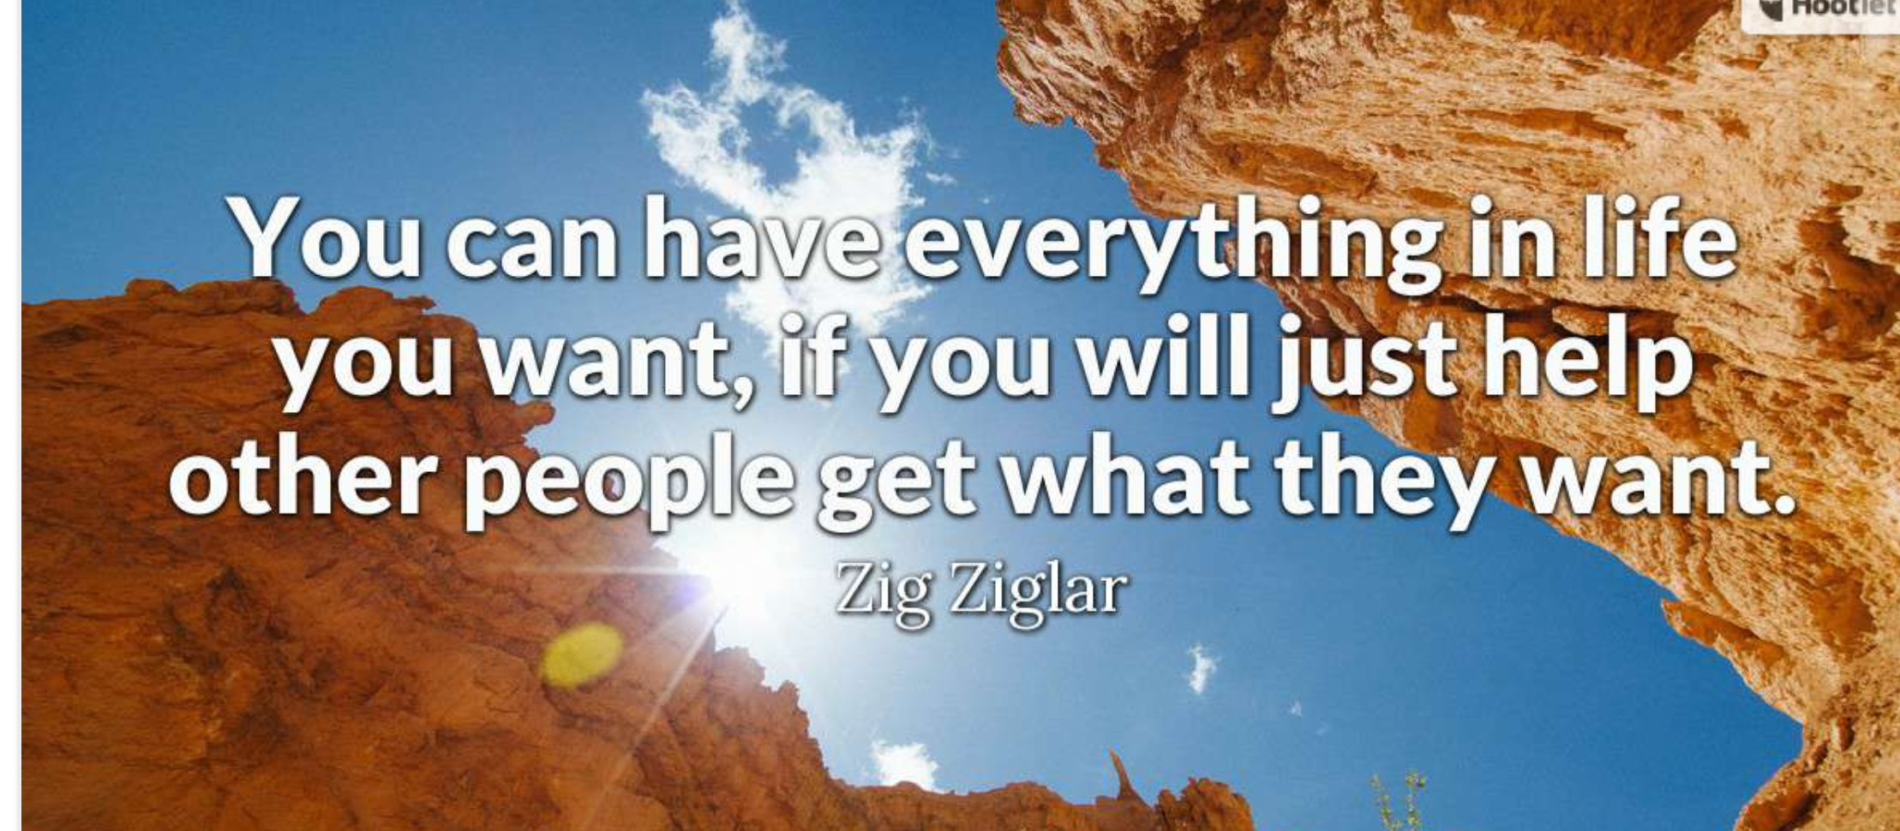
Notes:
Share your expertise
Connect employers with people
Connect your network

Slide 40
Best Practices

Slide 41
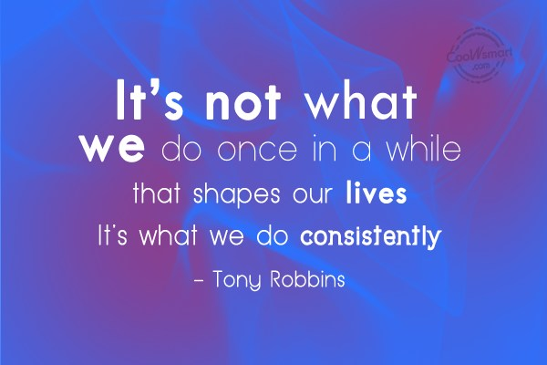

Slide 42
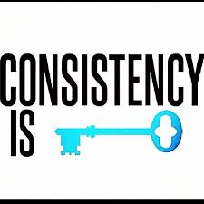
Consistency
Consider
Using the same profile photo on all channels.
The same key words & hashtags
Sharing content that reinforces your brand
Encouraging people who share your focus
Be observant

Slide 43

Minimize potential negatives regarding your brand
Remove anything potentially negative from all your social media - Facebook, Instagram, Twitter, etc.
Search yourself using multiple search engines (Google.com, Duckduckgo.com, Bing.com, etc.).
How are you doing? Is there anything—old blogs, embarrassing pictures—that you can take down completely?
Be Careful about your connections | Tagging options
Delete or consolidate accounts, remove tags of yourself from friends photos
Notes:
Note: For your social media, also be cognizant of photos or posts that people tag you in that could be negative that could show up in searchers

Slide 44
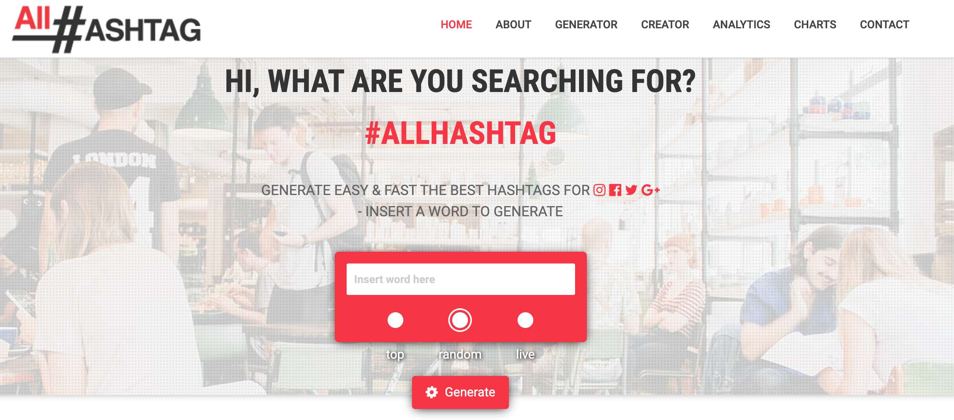
Use #Hashtags
For LinkedIn and Twitter include up to 3 niche hashtags to to help your posts be found
Resource for finding trending hashtags for your topic: all-hashtag.com

Slide 45
Post/Like Cautiously (even on your personal social media like FB & IG)
Political issues & religious posts
Videos with improper language
Inappropriate photos-excessive drinking, inappropriate language, polarizing/sensitive topics
Anything that could be offensive including hashtags
If you can’t say something nice, don’t say anything

Slide 46
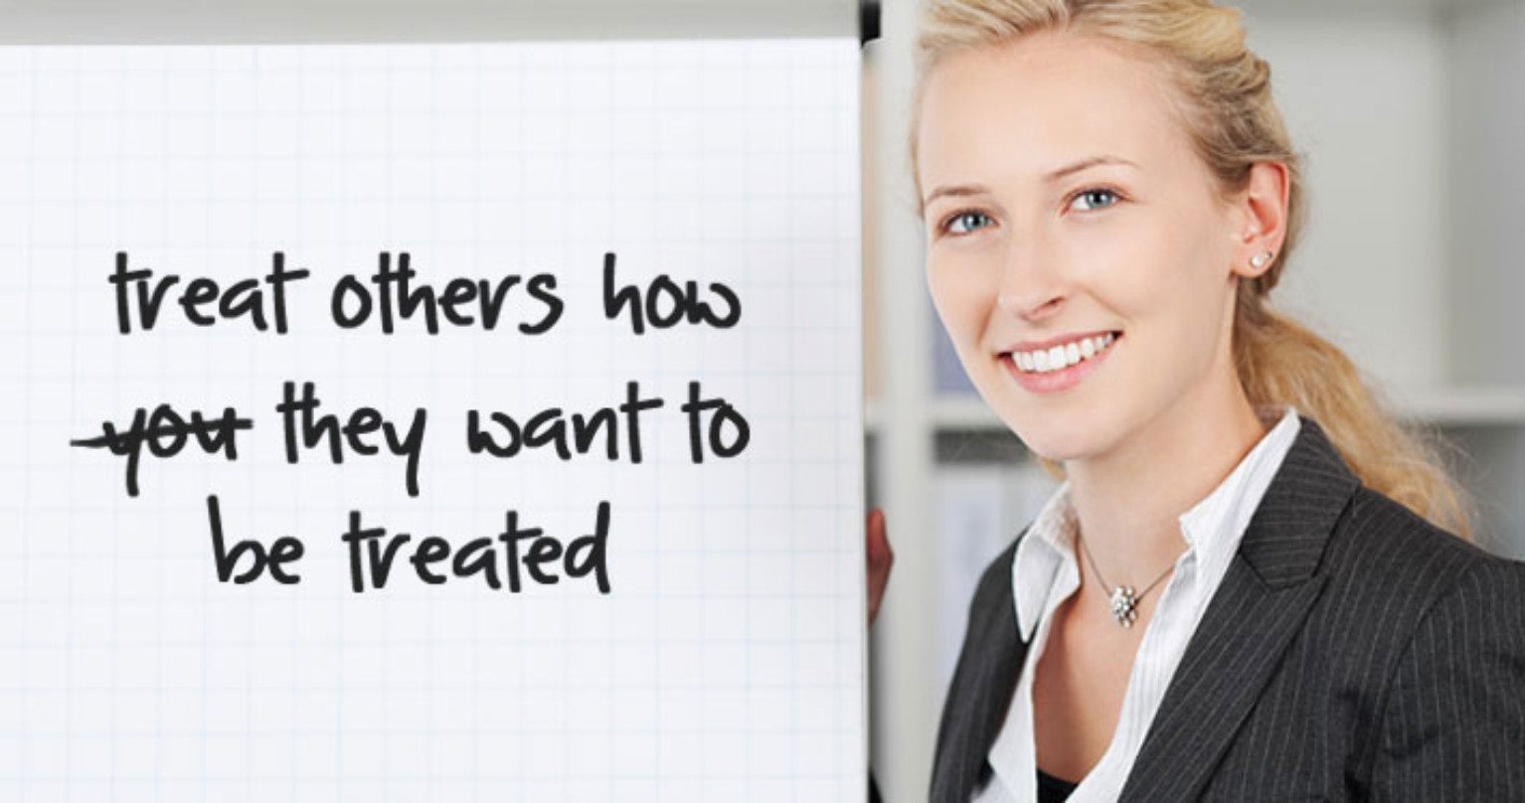
Networking Platinum Rule
All the more reason to follow the networking (online and offline) platinum rule, and network even when you don’t need a job.
Practice “give to get” networking and stay ever-connected to your network.
Networking is a lifelong exercise.
Notes:
Harry Gregori-Drone for the parade
Helping students
Networking resources document
Endorse your connections on LinkedIn
Write recommendations

Slide 47
Do this today:
Find your LI Social Selling Index: https://www.linkedin.com/sales/ssi
Follow LinkedIn News
Follow Richmond Biz Sense on LI and Twitter
Join LI groups for your industry and:
Career Prospectors
St. Michael Job Assistance Ministry – JAM
Plan what content you are going to share this week at the peak daily post times. Write at least one engaging post a day

Slide 48

Branding Homework
Spend time thinking about what inspires you- a picture, a quote, or a book.
Weave those elements into your profiles with keywords.
Make a concerted effort to have your actions reinforce your brand.

Slide 49


Slide 50
Resources
How To Find Your SSI LinkedIn Score
How to Calculate Your Social Selling Index on LinkedIn
How Many Connections Are Too Many?
https://www.photofeeler.com
How The Platinum Rule Trumps The Golden Rule
Top Social Media Mistakes To Avoid
10 Tips To Brand Yourself In the Job Market
https://privacy.com/

Slide 51
Contact/Questions
Leanne Raynor
leannerva@gmail.com
(804) 337-0861
Thank you for participating!

