Slide 1
Cybersecurity for the Job Seeker
Created by John Flynn
July, 2018

Slide 2
The Purpose of this Presentation
Job Seekers use the Internet a lot. There are hazards out there!
The Purpose of this Presentation is:
  To raise your awareness about the the threats you face
  To give you ideas and tools to stay as safe as you can
The Purpose of this Presentation is NOT:
  To make you an expert on cyber security
  To get into the technical aspects of cyber crime
  To explain every threat out there
  To ensure you will be safe on the ‘Net. No presentation can do that. Most of that is up to you.

Slide 3
Overview
Caveats
Basic terminology
Cybersecurity “test”
Cybercrime facts
What cybercrime can do to you
Ten ways to stay as safe as you can
If you get in trouble
Job scams
Electrical issues

Slide 4
Caveats
Doing anything to your computer is risky.
Doing stuff online is risky.
I have personally done everything I recommend here and had no problems, but that doesn’t guarantee anything on your computer.
The author and presenter of this presentation, as well as Career Prospectors and the Jobs Assistance Ministry assume no liability for any of the advice given in this presentation. If you are not sure as to whether or not to follow any of the advice given here, consult a computer security professional.
By listening/reading/participating past this slide, you accept, and agree to, the statement above.
The products talked about in this presentation are just for illustration. There is no financial interest here. There may be better products.

Slide 5
A few terms you need to know:
IoT: “Internet of things”
Malware
Hacking
Cookies
VPN
Firewall
URL

Slide 6
Cybersecurity Test
Botnet
Bluejacking
Bluesnarfing
KRACK
Keylogging
IoT Hacking
Mousetrapping
Pharming
Phishing
Ransomware
Scam Directory
Smishing
Spoofing
Spyware
Supercookie
Trojan
Typosquatting
Wi-Fi Eavesdropping
Worm
Zombie Cookie
For each threat, give yourself one point for:
Being able to define it.
Being able to explain how to protect against it?
Being protected against it.
Notes:
Botnet: a network of private computers infected with malicious software and controlled as a group without the owners' knowledge, e.g., to send spam message. Prevented by a firewall.
Bluejacking: the sending of unsolicited messages over Bluetooth to Bluetooth-enabled devices such as mobile phones, PDAs or laptop computers. Prevented by keeping your device up to date, turning Bluetooth off, making your Bluetooth undiscoverable and not responding to Bluetooth pairing requests.
Bluesnarfing is the theft of information from a wireless device through a Bluetooth connection. Bluetooth is a high-speed but very short-range wireless technology for exchanging data between desktop and mobile computers, personal digital assistants (PDAs), and other devices. Prevented by keeping your device up to date, turning Bluetooth off, making your Bluetooth undiscoverable and not responding to Bluetooth pairing requests.
KRACK: ("Key Reinstallation Attack") is an an attack on the Wi-Fi Protected Access protocol that secures Wi-Fi connections. Prevented by keeping firmware up to date, including IoT devices and using Ethernet.
Keylogging is the action of recording (logging) the keys struck on a keyboard, typically covertly, so that the person using the keyboard is unaware that their actions are being monitored. Data can then be retrieved by the person operating the logging program. A keylogger can be either software or hardware. This can be prevented by not letting unauthorized people have physical access to your computer.
The Internet of Things (IoT) is the network of physical devices, vehicles, home appliances, and other items embedded with electronics, software, sensors, actuators, and connectivity which enables these things to connect and exchange data. Examples are Internet and Bluetooth based door locks, smart speakers and security systems. This is a whole new area for potential security problems and the remedies are up to the manufacturers of the devices.
Mousetrapping is a technique used by some websites to keep visitors from leaving their website. Stopped by disabling JavaScript or restarting your computer. Foiled by not doing whatever the mousetrap wants you to do and closing/reopening your browser.
Pharming is directing Internet users to a bogus website that mimics the appearance of a legitimate one, in order to obtain personal information such as passwords, account numbers, etc.
Phishing is the fraudulent attempt to obtain sensitive information such as usernames, passwords, and credit card details (and money), often for malicious reasons, by disguising as a trustworthy entity in an electronic communication. Foiled by making sure the requests are trustworthy and following warnings on your browser.
Ransomware is malware that gets on your computer and gives you a demand to pay money by a certain date/time or your computer and/or files will be damaged, destroyed or deleted. Prevention is a good anti-virus or firewall. Mitigation is to get your computer to an expert.
Scam Directory: You are contacted by someone with some information about you or your organization and they say they want to update your information. What they really want is information they don’t already have. Prevent this by not falling for it.
Smishing is Phising through SMS text. You get a text asking for personal information. Foiled by not answering it and blocking the texting number.
Spoofing: A person or system masquerading as another by falsifying data, to gain an illegitimate advantage. Foiled by paying attention to the details of the URL you in.
Spyware: Malware that gathers information about you without you knowing it. Prevented by security software.
Super Cookie: A cookie with an origin of a top-level domain (such as .com) or a public suffix (such as .co.uk). Ordinary cookies, by contrast, have an origin of a specific domain name, such as example.com. They can potentially disrupt or impersonate legitimate user requests to another website. They can be avoided by keeping your browser software up to date.
Trojan: A program you load that does something you want, but is also contains malware. This is prevented by checking out software before loading it.
Typosqautting: A type of spoofing where a website is set up that looks like a site you want to visit and the URL is spelled almost the same. Example: Amzon.com. People get snagged when the type in the URL and accidentally misspell it. This can be prevented to looking the URLs you visit. Also, a password program can help, but storing correctly spelled URLs.
Wi-Fi Eavesdropping: A hacker monitors what you are doing on your computer to get your information. This can be prevented by using a VPN.
Worm: A standalone malware computer program that replicates itself in order to spread to other computers. Minimized by keeping your computer’s operating system and other software up to date, avoiding opening unrecognized or unexpected emails and running firewall and antivirus software.
Zombie Cookie: A cookie that recreates itself after you delete it. It can be prevented by not allowing third-party cookies, not visiting websites that your browser warns you about and keeping your browser software up to date.

Slide 7
Tally up your scores
45-60: Pretty good!
30-44: Vulnerable
Under 30: Just waiting to be a victim

Slide 8
Cybercrime Facts
One in 131 emails contain malware.*
More than 4,000 ransomware attacks occur every day.*
  The average amount demanded after a ransomware attack is $1,077.
  64% of Americans are willing to pay it.
According to billionaire investor Warren Buffett, cyber attacks are the BIGGEST threat to mankind — even more than nuclear weapons.*
230,000 new pieces of malware are produced every day.*
User mistakes account for almost as many cyber crimes as hacking and malware.*
* “Cyber Security Statistics” by John Mason, February 27, 2018 “The Best VPN” website

Slide 9
Cybercrime Facts, continued
78 percent of people claim to know the risks that come with clicking unknown links in emails and yet they still click these links.*
Android is the second most targeted platform by hackers after Windows.*
Virginia is #6 in the nation for cybercrime victims and #13 in dollar amount of losses.**
Unfilled cyber security jobs are expected to reach 3.5 million by 2021 — compared to about 1 million in 2016.*
* “Cyber Security Statistics” by John Mason, February 27, 2018 “The Best VPN” website
** FBI Internet Crime Report 2017

Slide 10
What Cybercrime can do to you:
Steal your passwords
Use your credit cards and drain your bank account
Access your personal information
Reformat the hard drive of your computer causing you to lose all your information
Allow people to watch you through your webcam and hear you though your microphone without you knowing it
Get your computer to spread all types of malware to other computers
Take control of your computer and hold it for ransom
Alter or delete your files

Slide 11
What Cybercrime can do to you, continued :
Send emails on your behalf, including compromising emails that could get your fired or blacklisted
Order things online from your Amazon or other online accounts
Make your email unusable
Cause ad popups on your computer
Steal your contact list
Record usernames, passwords and other personal information
Hijack your web browser
Disable your security settings

Slide 12
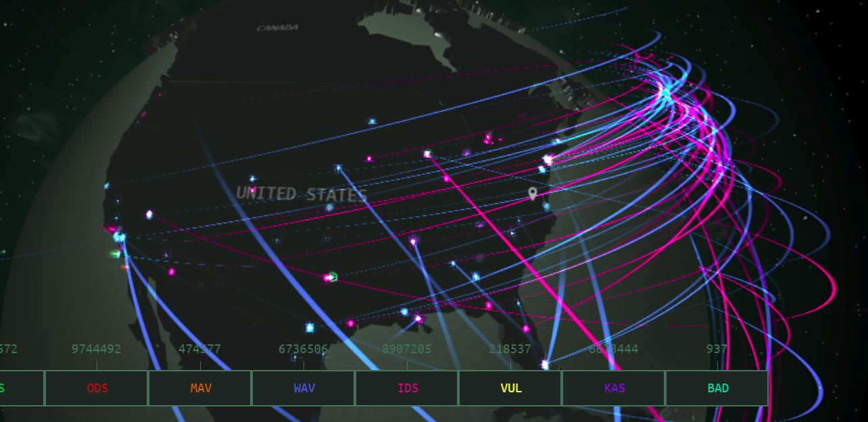
Cybercrime, Real Time
https://cybermap.kaspersky.com/

Slide 13
Ten Ways to Stay as Safe as you Can
Keep Your software and apps up to date
Use anti-virus protection & a firewall
Use strong passwords and a password management tool
Use multi-factor authentication
Be very suspicious of emails you weren’t expecting.
Protect your Personal Identifiable Information (PII)
Use your mobile devices securely
Backup Your data regularly
Use a VPN on public Wi-Fi
Don’t let unauthorized people have physical access to your computer.

Slide 14
1. Keep Your Software and Apps Up to Date
Includes:
  Operating System
  Programs
  Anti-Virus
  Firewall
  Mobile Device Apps
Turn on automatic updates
Check for updates from time to time
Remember: A hacker can use a common, benign program to get into your computer. Adobe Acrobat is an example.

Slide 15
1A. Uninstall Programs and Apps You Don’t Need
Check installed programs from time to time:
  Learn how to do this on your operating system
  If you don’t recognize a program/app, look it up online. If it doesn’t do anything you need it to do, get rid of it.
    There are sites that will tell you what a program does and if you should uninstall it. I check multiple sites before making a decision.
  If a program/app has been installed without your knowledge, you might want to get rid of it.

Slide 16
2. Top Anti-Virus/Firewall Programs per “Consumer Reports”
Windows
Mac
Free
  Bitdefender
  Avast
  Avira
Suites (paid)
  Bitdefender
  Norton
  Trend Micro
  Kaspersky
Free
  Avira
  Avast
  AVG
Suites (paid)
  Norton
  G Data
  Kaspersky
  Bitdefender
Keep your anti-virus up-to-date!

Slide 17
3. Use Strong Passwords
Different password for every program/site
Password requirements
  8 characters minimum, 12 is better
  Uppercase, lowercase, numbers and special characters
Intelligent vs. unintelligent passwords
  Intelligent = A word or phrase that means something so you will remember it
    Example: C@reerPr0spectors
    Use intelligent when you need to remember, but don’t make anything someone could begin to guess.
  Unintelligent = Complete gibberish, which is harder to crack
    Example: S/5>,.^2466|
    Use unintelligent with a password keeper, like Password Safe

Slide 18
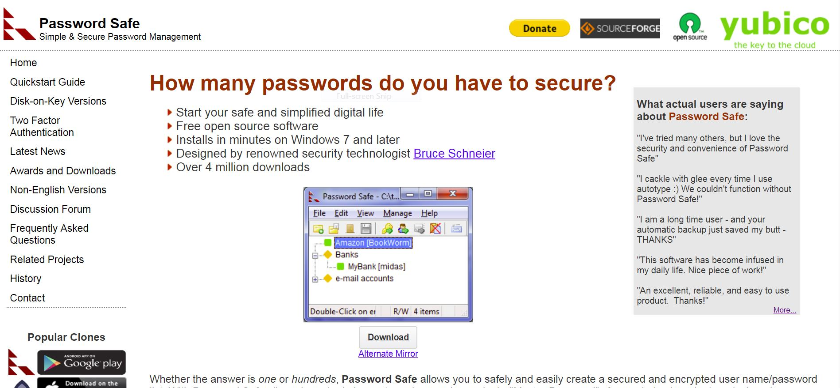
4. Use a Good Password Management Tool
pwsafe.org

Slide 19
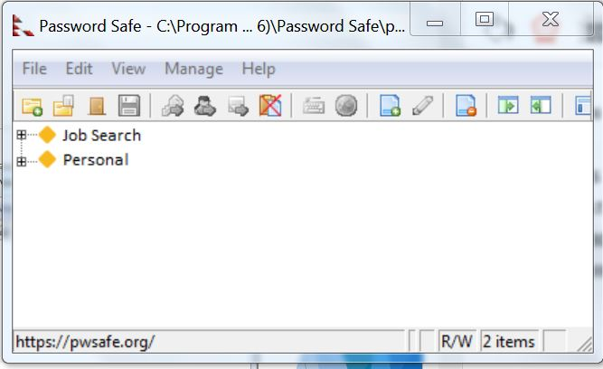
4b. Password Safe Demo
Notes:
NOTE: There are demos on YouTube.

Slide 20
5. Multi-Factor Authentication
Various sites give you the option of two factor authentication
  Banks
  Amazon
  PayPal
  Google
  Many others
To log in, you use your password as you normally would, then you get the option to send a code to your phone or email. You enter that code before you can get in.
Multi-factor authentication is the most secure process there is for the average user!!!

Slide 21
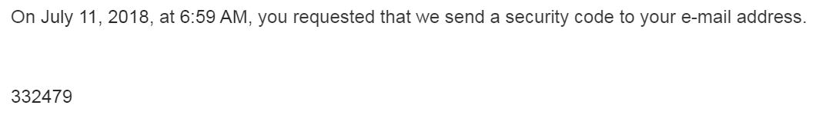
5a. Multi-Factor Authentication

Slide 22
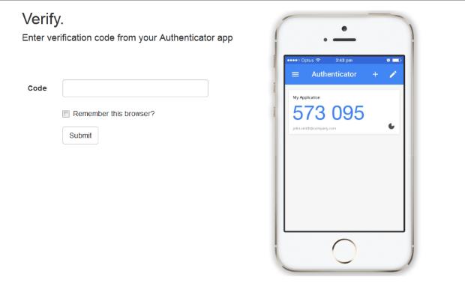
5b. Multi-Factor Authentication

Slide 23
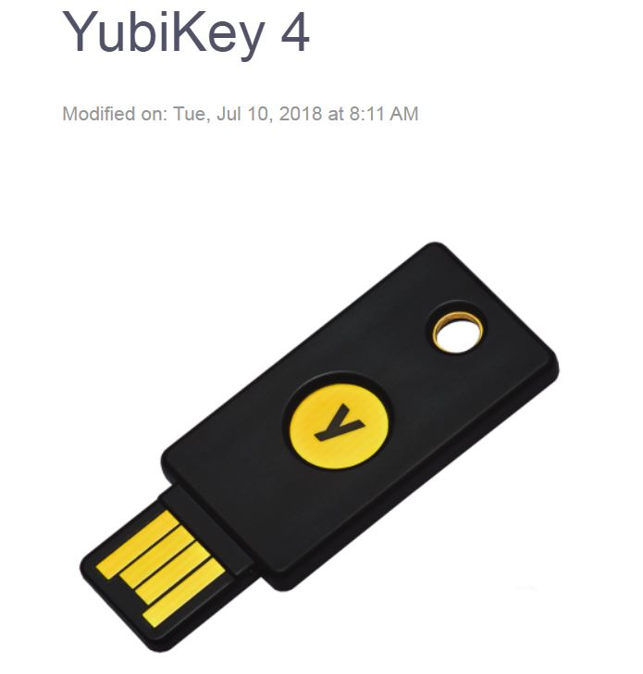
5c. Multi-Factor Authentication

Slide 24
6. Protect your Personal Identifying Information (PII) and financial information
PII includes all information which can be used to distinguish or trace an individual's identity, such as:
  Name
  Social security number
  Date and place of birth
  Mother's maiden name
  Biometric records

Slide 25
6a. Protect your Personal Identifying Information (PII) and financial information
Financial Information Includes:
  Credit card numbers
  Bank account numbers
  Loan numbers
  Insurance account numbers
Do not give this information out on an inbound request!
  Inbound = They are contacting you.
  Outbound = You are contacting them at an address or phone number you know is correct.
If you need to provide that kind of information, arrange an outbound method

Slide 26
7 - 8
Use your mobile devices securely.
  All the precautions you take for computers apply to mobile devices.
  Use a security suite on your phone.
  Use a password management program on your phone.
Backup Your data regularly.
  External hard drives are relatively cheap.
  You data is a valuable and sometimes irreplaceable asset! It does not take much effort to back it up.

Slide 27
9 - 10
Use a Virtual Private Network (VPN) on public Wi-Fi.
  You can get VPN service from some security suites.
Don’t let unauthorized people have physical access to your computer.
  A lot of computers are stolen from cars, hotel rooms, meeting rooms, etc.
  The main defense is keep your computer out of sight, or physically with you.
  A good cable lock is a good investment.

Slide 28
Public Computer Security
When you use a public computer, like at the library, always delete all browsing history from the operating system and the browser you used.
Then: Re-launch the browser, visit the website you were in, like LinkedIn, and see if it treats you as a new user, or as return user without you logging in. If it logs you in automatically, the step above did not delete your password.
At the Tuckahoe Library, I was told the only sure way to clear your history is to shut the computer down. When it reboots, it is programmed to start with a clean image.
Remember: A hacker could possibly put malware in a public computer and get it to capture your data.

Slide 29
Hints you my have have been hacked – infected - scammed
It takes longer than usual for your computer to start up, it restarts on its own or doesn't start up at all.
It takes a long time to launch a program.
Files and data have disappeared.
Your system and programs crash constantly.
The homepage you set on your web browser is different (note that this could be caused by Adware that has been installed on your computer).
Web pages are slow to load.
Your computer screen looks distorted.
Programs are running without your control.
But your computer could have none of these problems and still be infected!

Slide 30
If all else fails – if you get hacked – infected – attacked - scammed
Don’t give the attacker what they want
Revert to your backup(s)
See if your security suite can sort it out
Go to a professional
If your email has been hacked or spambotted, you may have to abandon the account and open a new one.
  Send an email and a reminder to your contact list about the change, using the new email.
  Check the old account every week or so for a few weeks to see if there are any contacts sending you messages you missed.
Depending the type of attack, there are government agencies to report the attack to.

Slide 31
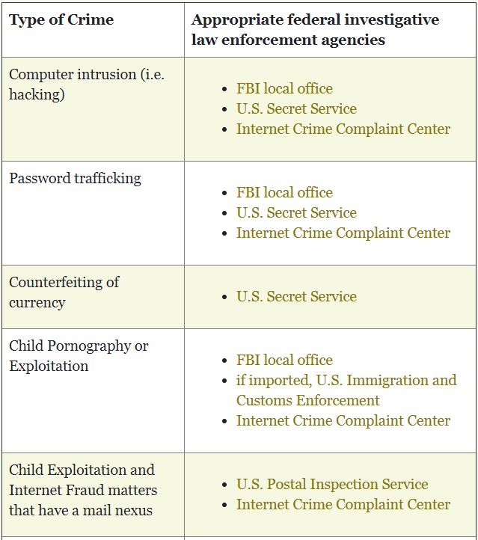
Agencies you can report cybercrime to

Slide 32
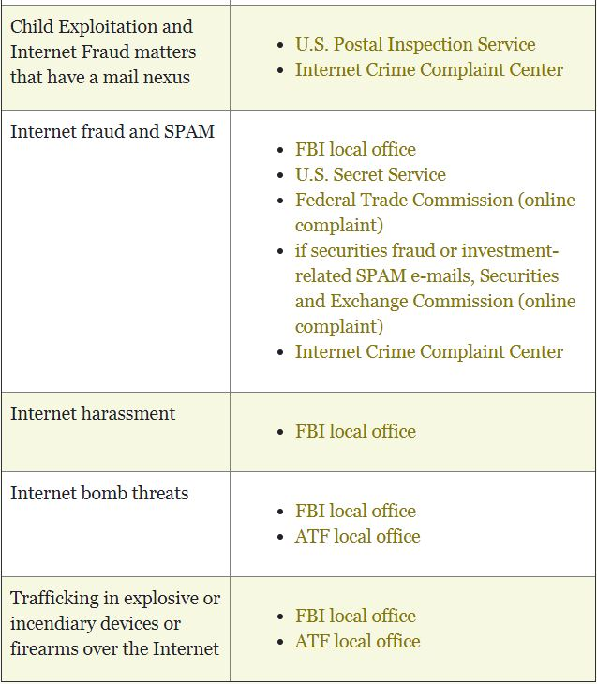
Agencies you can report cybercrime to

Slide 33
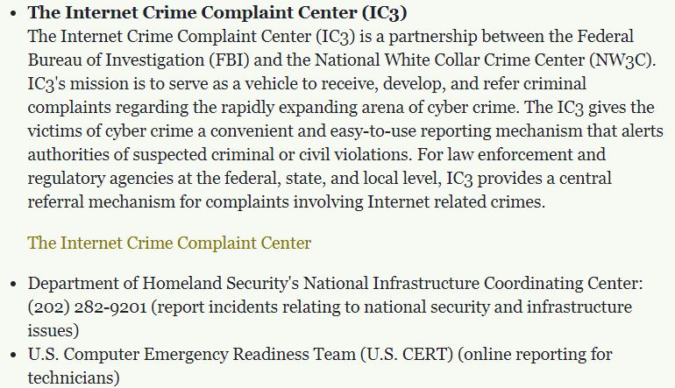
Agencies you can report cybercrime to

Slide 34
Job Scams
This is a variation on the “contest scam.” Instead of winning a contest, you are presented with a “perfect” job opportunity by phone or email.
Their purpose: To get you to respond, click on dangerous sites and provide your personal information.

Slide 35
How to Spot Job Scams
A recruiter contacts you out of the blue and doesn't say how they heard of you.
They obviously have no clue what you are looking for or are good at. They may say they found you on LinkedIn, but the job offered has nothing to do with your profile.
The job sounds too good to be true.
The job sounds like something that doesn’t really need to be done or would be easy to find someone to do.
The job requirements and/or description are vague or illogical.
The email is unprofessional: Spelling, grammar, etc.
A job scam may have none of these characteristics, but still be dangerous.

Slide 36
How to Spot Job Scams, continued
The email doesn’t have contact information from the sender, it says not to reply to the email and/or the sending address is a personal address, not the address of the company or recruiter mentioned.
Your online research can’t find the hiring company or the recruiter’s company, or their website doesn’t seem right.
You are asked to provide confidential info.
They want you to pay for something.
Your browser or security software says the message may be a threat.
Your gut says it’s a scam.
A job scam may have none of these characteristics, but still be dangerous.

Slide 37
One other thought...
It’s not unusual to have a computer destroyed by a power surge.
A dentist in Midlothian recently had his office computer “fried” due to a thunderstorm...even though it had a high-quality surge protector on both the power line and the Ethernet cable. It cost him $1,800 to replace it. Fortunately, all the data was backed up.
A surge can do as much damage as hacking
Surges can happen for lots of reasons: Static electricity, a power outage coming back on, etc.
I recommend at least:
  Using a quality surge protector
  Turning your computer off during a thunderstorm
  Unplugging the computer during a power outage

