Slide 1
Accomplishments Stories Workshop SOAR/STAR
Kevin Bunting

Slide 2
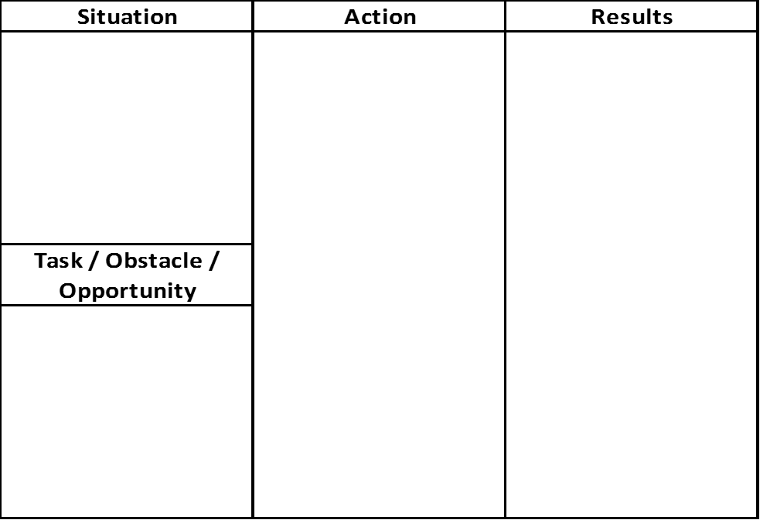

Slide 3
Situation – Describe the situation
“When I was a Sales Director at HP…”
Obstacles – What challenges or problems existed?
“I had challenges with my sales team aligning with the PC marketing team…”
Opportunity – What did you see?
“I needed to improve how the individual contributors worked together to stop the blame game…”
Task – What was assigned to you?
“I worked with PC Marketing management and was able to insert my team into the interview process…”
Actions – What did I do to overcome obstacles?
“My sales reps were able to interview and approve the final candidate to ensure that they were compatible, agree on ground rules and aligned on how they would work together…”
Results – What were your achievements?
“Because of this process my sales team was integrated into the product marketing organization. They had ownership in the hiring decision and became completely focused on expanding margins and driving revenue not on personality or work style issues.”

Slide 4
Bad Example:
Working with the PC category I designed a new process to hire the PC marketing rep dedicated to my account. This involved having my sales reps inserted into the interview process. The old process was completely owned by the PC category with no thought given to compatibility or an understanding of the partnership with sales. The process ensured alignment between the sales and marketing individual contributors. Because of the new process, marketing and sales were mutually committed to how we were going to work together. This was a significant change and ensured that the sales team felt ownership and commitment to the partnership and enabling the focus to be on driving the business not on personalities.

Slide 5
SOAR Format:
Situation: When I was the Sales Director for the Circuit City account team
Task / Obstacle / Opportunity: I had a on-going challenge getting alignment and compatibility between the PC sales and PC marketing reps.
Action: I worked with the PC marketing management team to get my sales rep inserted into the hiring/interview process.
Results: Because my sales reps were involved in the process, they had ownership and felt a sense of responsibility for the success of the relationship. As a result, the focus became about working together and growing the business for HP and Circuit City

Slide 6
Be able to Answer these SOAR questions:
What is your greatest achievement?
Tell about a challenge or problem at work, and how you dealt with it.
Tell about a time you made a mistake and how you recovered.

Slide 7
Other SOAR question examples:
Tell me about a time when you had to deal with a difficult client or coworker.
Give me an example of when you had to sell your boss on a new product, service, system, or program.
Give me an example of a problem you faced on the job and how you handled it.
Give me an example of how you dealt with an employee who was not performing up to expectations.
Give me a recent example of how you went about motivating your coworkers and subordinates.
Recall for me a time when you challenged your boss and/or company policy.
Tell me what you did in your last job to help build teamwork.

